Slide 1


FULL STACK WEB DEVELOPMENT WITH JAVA
Lecture-2
(Introduction To JDBC)

Slide 2
Today’s Agenda
Introduction To JDBC
Introduction To DBMS
History And Editions Of JDBC
JDBC Architecture
How JDBC Manages Connections To The Database ?

Slide 3
QUIZ
Q1. What does Java EE stand for ?
A. Java Expert Edition
B. Java Enterprise Edition
C. Java Extra Edition
D. None Of These
Answer: B

Slide 4
QUIZ
Q2. What kind of applications can be built using JEE?
A. Web Applications
B. Console Applications
C. System Level Applications
D. GUI Applications
Answer: A

Slide 5
QUIZ
Q3. What is JAVA EE?
A. A programming language
B. A set of java tools
C. A compiler
D. A platform
Answer: D

Slide 6
QUIZ
Q4. What is a Request ?
A. Message sent by the browser for getting static page
B. Message sent by the browser for getting dynamic page
C. Both A & B
D. None Of These
Answer: C

Slide 7
Introduction To JDBC
Unofficial full-form of JDBC is Java Database Connectivity.
It is an API used for connecting programs written in Java with the Relational Database.
Programs developed with Java/JDBC are platform and vendor independent.

Slide 8
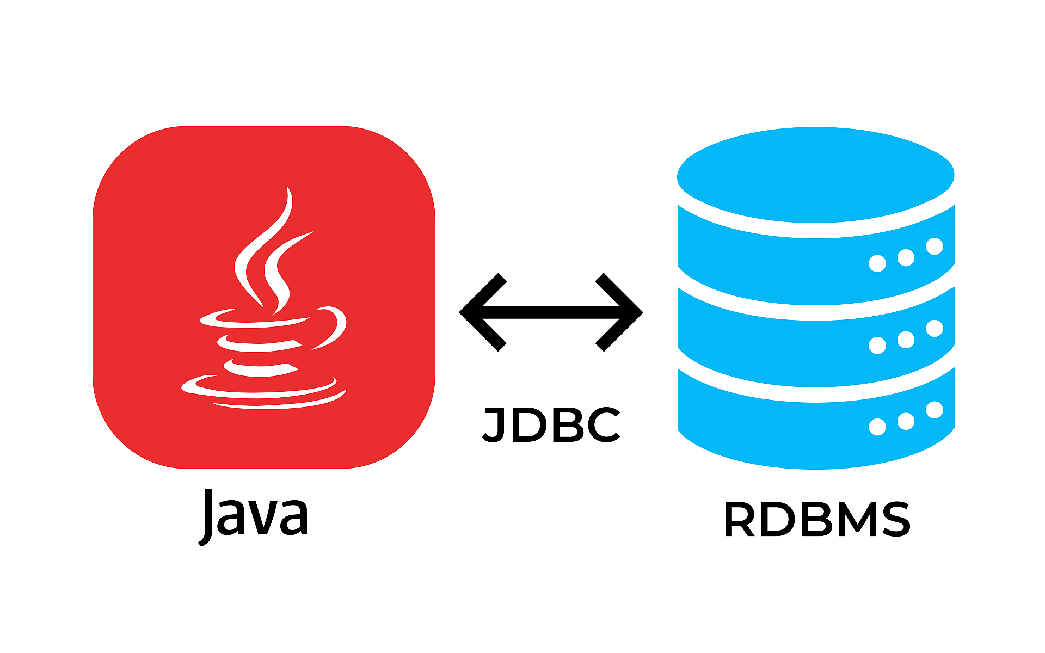
Introduction To JDBC

Slide 9
Introduction To DBMS
Before we learn more about JDBC, let's first understand -
What is Data?
What is Database ?
What is DBMS ?
What is SQL ?

Slide 10
Introduction To DBMS
What is Data?
In simple words data can be facts or information.
For example your name, population of a country , names of political parties in your country , today’s temperature etc
A picture , image , file , pdf etc can also be considered data.

Slide 11
Introduction To DBMS
What is a Database?
A database is a collection of inter-related data or information that is organized so that it can easily be accessed, managed, and updated .
Let's discuss few examples.
Your mobile’s phone book is a database as it stores data pertaining to people like their phone numbers, name and other contact details etc.
Your University uses database to store student details like enrollment no, name , address , academic performance etc
Let's also consider the Facebook. It needs to store, manipulate and present data related to members, their friends, member activities, messages, advertisements and lot more. Here also database is used

Slide 12
How Databases Store The Data ?
Most of the databases store their data in the form of tables
Each table in a database has one or more columns, and each column is assigned a specific data type, such as number, a sequence of characters (for text), or a date.
Each row in the table has a value for each column.

Slide 13
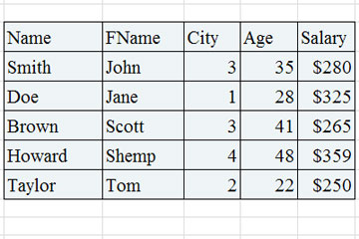
How Databases Store The Data ?

Slide 14
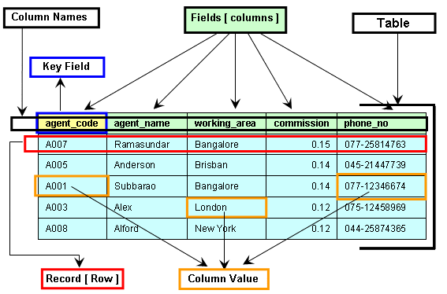
Components Of A Table

Slide 15
What Is A DBMS ?
A DBMS is a program or a software that allows users to perform different operations on a database.
These operations include:
Creating the database/tables
Inserting records into these tables
Selecting records from these tables for displaying
Updating / Deleting the records

Slide 16
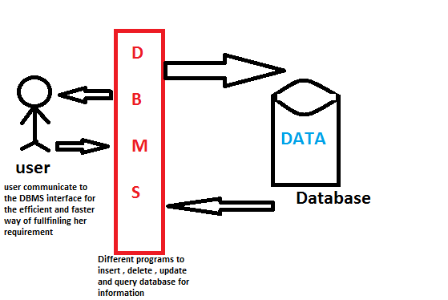
What Is A DBMS ?

Slide 17
Some Popular DBMS
Some of the most popular DBMS are:
Oracle
MySQL
MS SQL Server
SQLite
PostgreSQL
IBM DB2
and many more

Slide 18
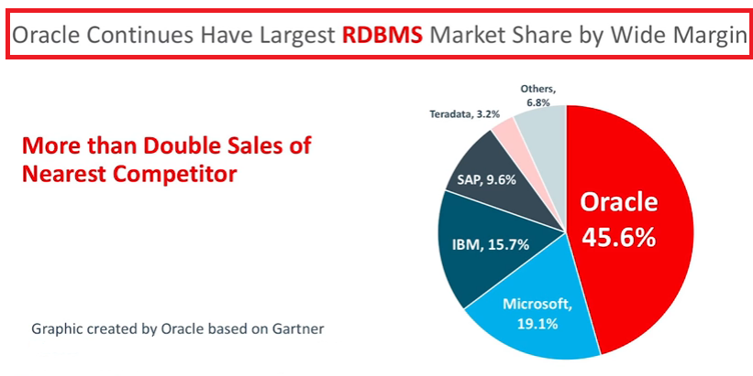
The Market Leader

Slide 19
What Is SQL ?
SQL is an abbreviation for “Structured Query Language”.
It is a language used by EVERY DBMS to interact with the database.
It provides us COMMANDS for inserting data to a database, selecting data from the database and modifying data in the database

Slide 20
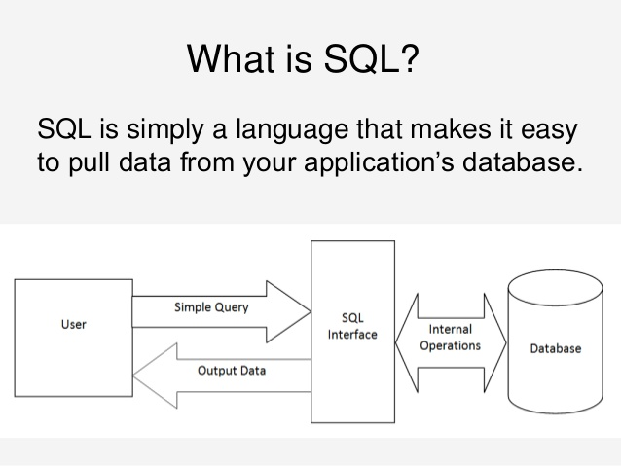
Pictorial View Of SQL

Slide 21
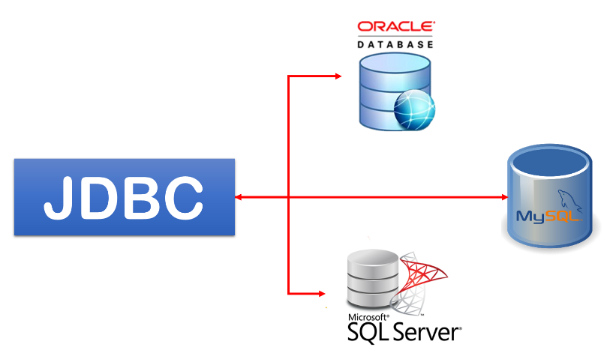
Introduction To JDBC

Slide 22
History And Edition
JDBC is maintained by JavaSoft, a sister concern of Oracle.
It was released as a part of JDK 1.1 and was called JDBC 1.0.
Later in 2006 , with Java 6, JDBC 4.0 was released
Java SE 9 includes the latest version of JDBC called JDBC 4.3

Slide 23
How JDBC Maintains Connection To The Database ?
JDBC communicates with the database using a special set of classes called Driver classes .
These Driver classes perform the real communication with the database in it’s native form.
Further to manage these Driver classes the JDBC API provides another top level class called DriverManager

Slide 24
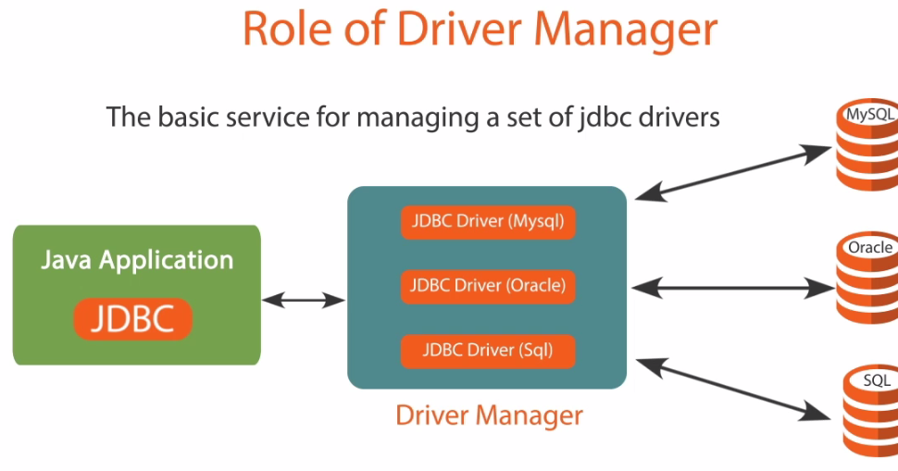
How JDBC Maintains Connection To The Database ?

Slide 25
JDBC Driver Types
Today, there are four types of JDBC drivers in use:
Type 1: JDBC-ODBC bridge Driver.
Type 2: Native Driver.
Type 3: Network API Driver
Type 4: Pure Java Driver

Slide 26
JDBC-ODBC Bridge Driver
The JDBC-ODBC bridge driver uses ODBC driver to connect to the database.
ODBC stands for Open Database Connectivity and is a Microsoft technology
The JDBC-ODBC bridge driver converts JDBC method calls into the ODBC function calls.

Slide 27
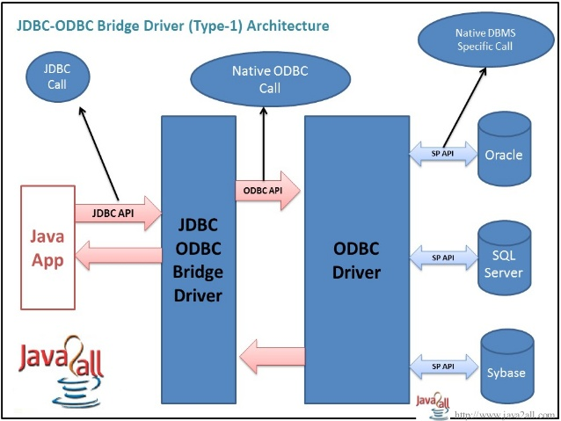
Architecture

Slide 28
JDBC-ODBC Bridge
Advantage:
Can be used to connect with variety of databases.
No installation required as it comes bundled with JDK.
Continued

Slide 29
JDBC-ODBC Bridge
Disadvantage:
This is the slowest driver.
Since it is a Microsoft technology so our Java application can use it only when it runs on Windows platform.
It only supports basic SQL types like varchar2,number,date but doesn’t supports advanced types like BLOB,CLOB etc
Continued

Slide 30
Pure Java Driver
It is also called thin driver or vendor specific driver.
This is because it converts JDBC calls directly into the vendor specific database protocol.
Moreover it is fully written in Java language.
Continued

Slide 31
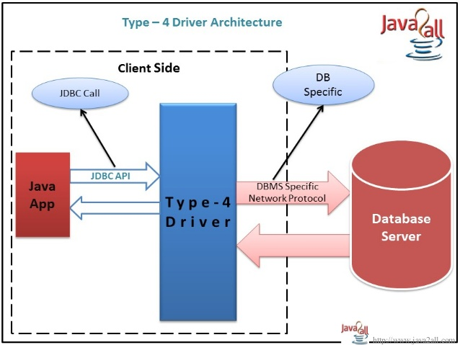
Architecture

Slide 32
Advantage And Disadvantage
ADVANTAGE:
Better performance
No middleware is needed while connecting to the database.
DISADVANTAGE:
Drivers are dependent on database.
There is a separate driver for each database.

